Slide 1
Embedded Systems
Introduction

Slide 2

Embedded Systems
Definition
“Any combination of Hardware and Software
which is intended to do a
Specific Task
can be called as an Embedded System”

Slide 3
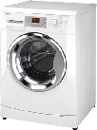

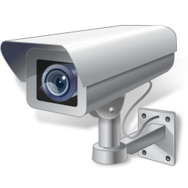
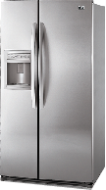
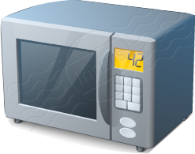
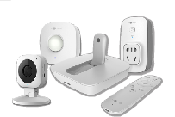
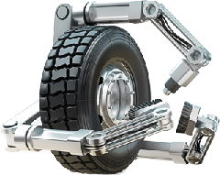

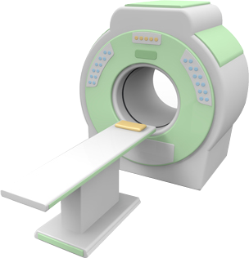
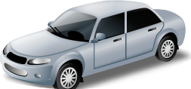
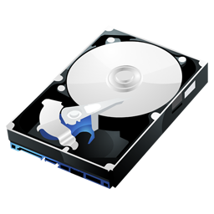

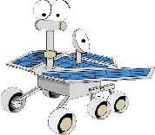

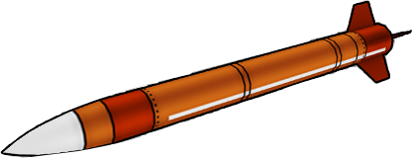
Embedded Systems
Examples

Slide 4
Embedded Systems
Categories
Stand-alone
Real Time
Networked
Mobile

Slide 5

Embedded Systems
Components
Software
Actuators
DAC
uC
or
SOC
or
uP
Memory
FPGA/ASIC
Sensors
ADC
Auxiliary
System
(Power, Cooling)
Human
Interfaces
Diagnostic
Port

Slide 6
Thank You

